Slide 1
Experimental Definition in SynchWeb for XPDF
Tim Spain
ISPyB meeting
2018-01-31

Slide 2
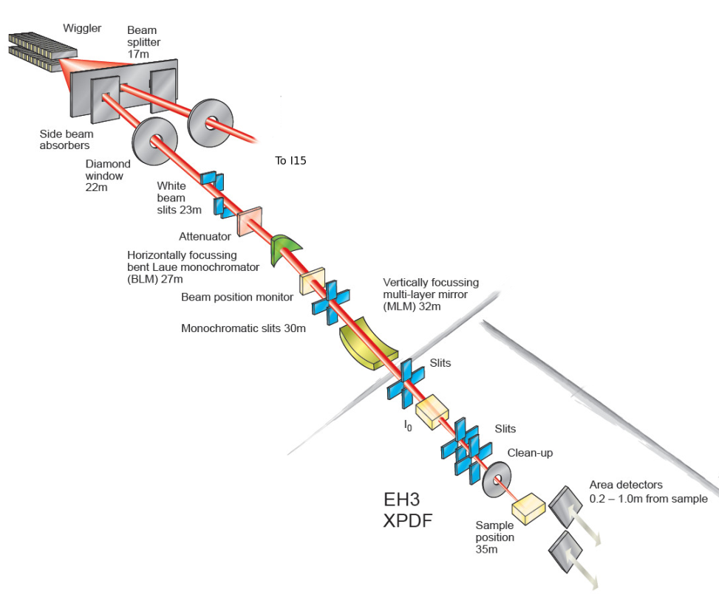
XPDF on I15-1
Dedicated X-ray Pair Distribution Function beamline
Targetting PDF users who are not synchrotron experts
Using ISPyB and SynchWeb to drive eventual automated experiments

Slide 3
Goals and targets
Experimental definition in SynchWeb
Automatic experimental execution by GDA from the ISPyB database
Storage of metadata from the beamline to the database
Automatic processing of the data on the Diamond compute cluster
Materials and shapes of the target components
Data and metadata from the DB
Storage of the processing metadata to the database

Slide 4
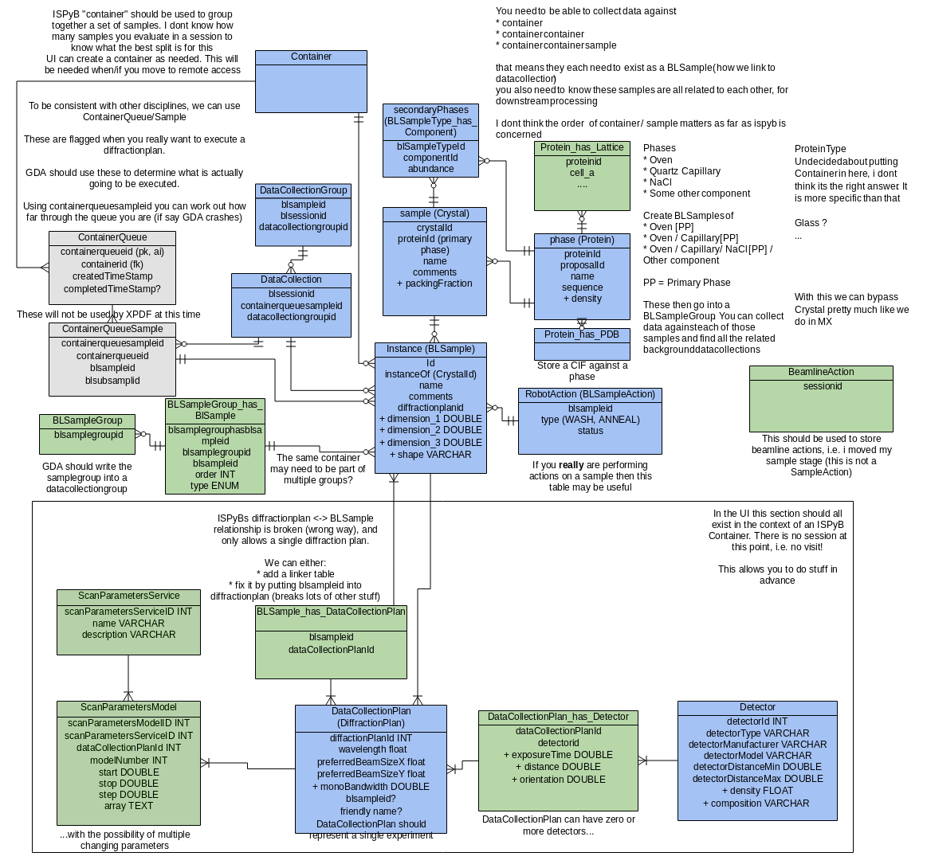
Database changes

Slide 5
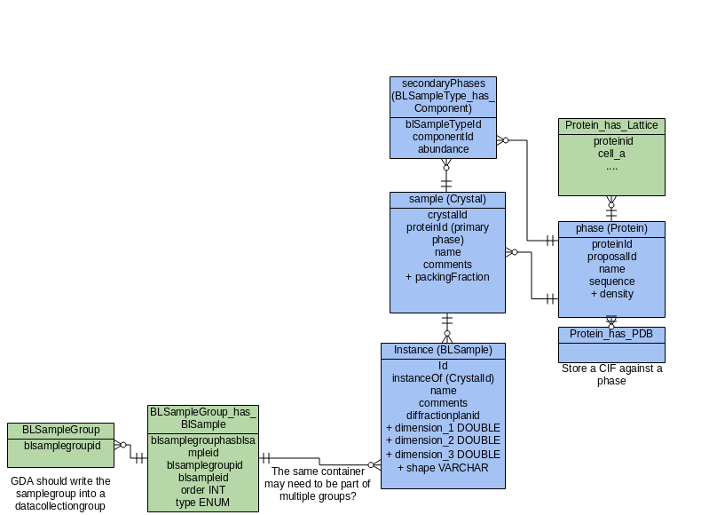
Defining target parameters

Slide 6
Defining target parameters
Need to subtract (best estimate of) radiation scattered by everything that is not the sample
Composition
Shape and size
Concept of what surrounds what
“Streamality”

Slide 7
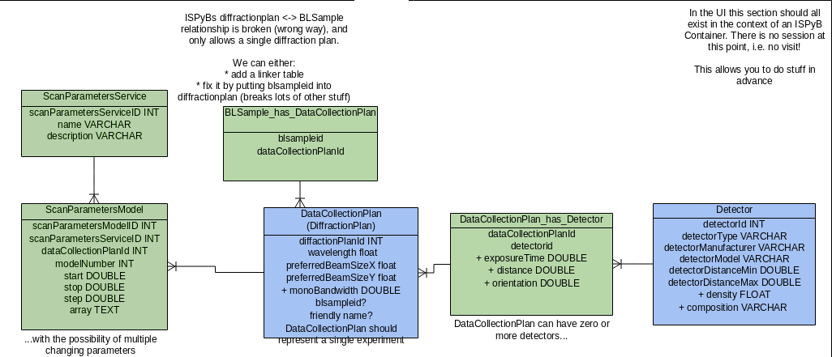
Defining experimental conditions

Slide 8
Defining experimental conditions
Beamline energy
Exposure time
Detectors, including position and roll
Close PDF Detector
Distant Bragg Detector
Detector properties (composition, thickness)
Environmental conditions
Parameters scanned over
Order of scanning for multiple parameters

Slide 9
SynchWeb changes
Aim for commonality with current MX design
New workflow to define samples and experiments
Currently sub-optimal, according to beamline staff
Making Crystal rows visible and editable
Build Crystals (samples¹) from Proteins (phases)
Make BLSamples (instances)
Wrap sample instances in container instances
Whole new page for defining all the experiments to be run on a container (sample changer)

Slide 10
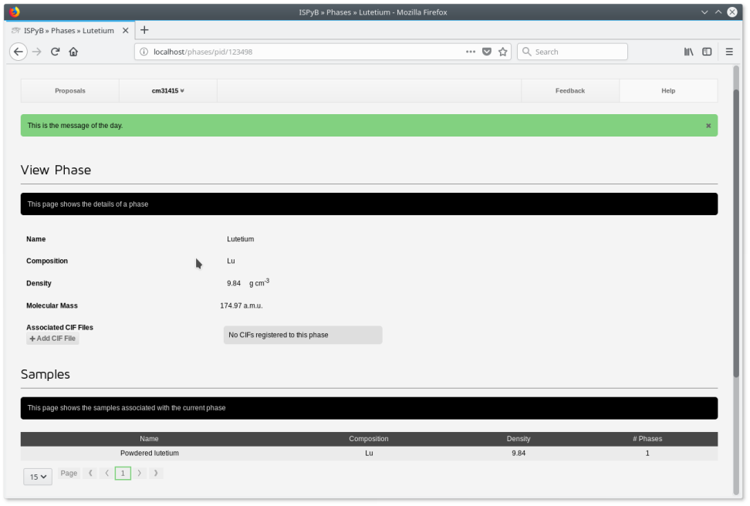
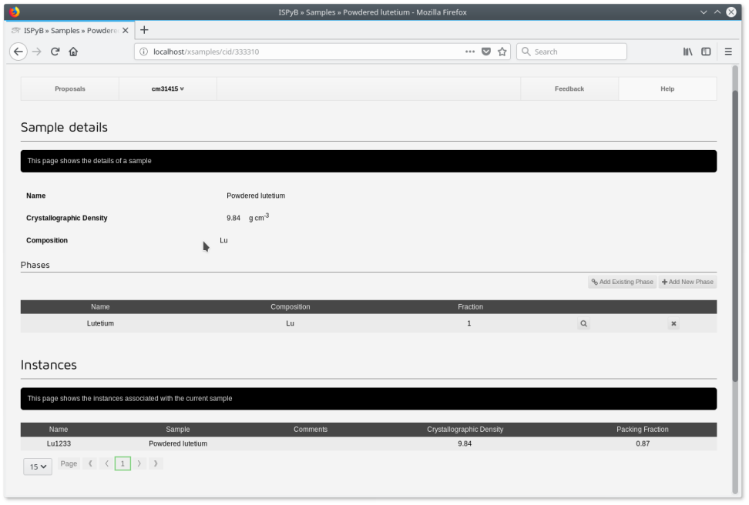
Sample definition
Protein (phase)
Crystal (sample)

Slide 11
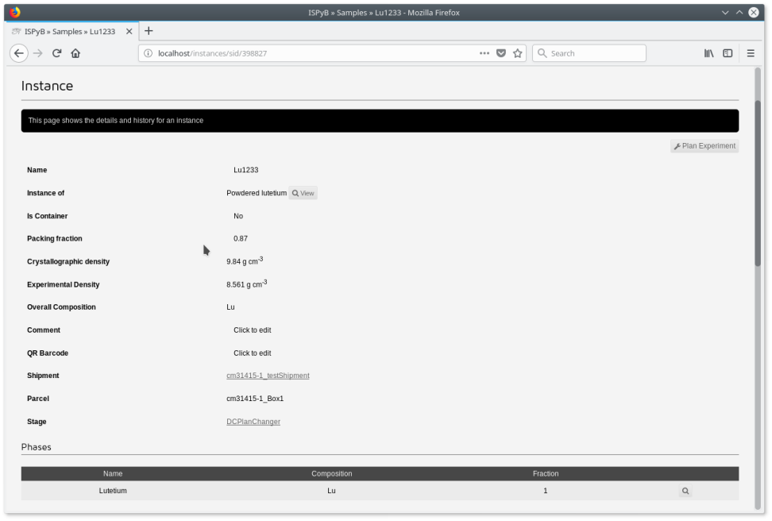
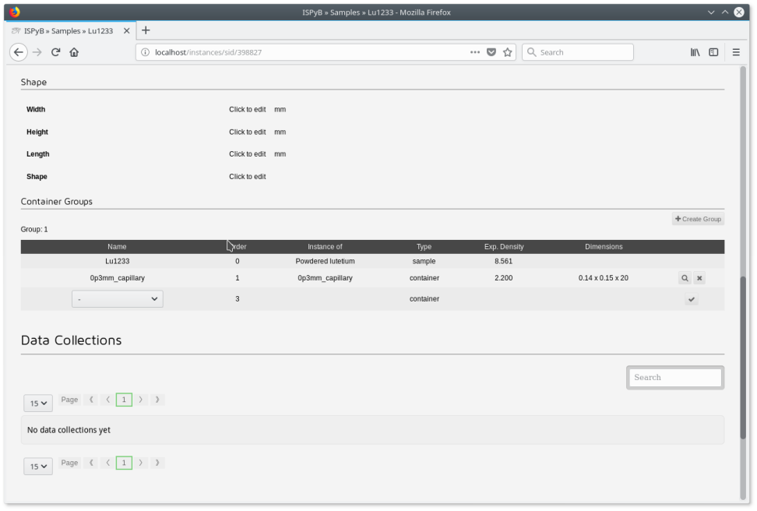
Sample definition
Instance

Slide 12
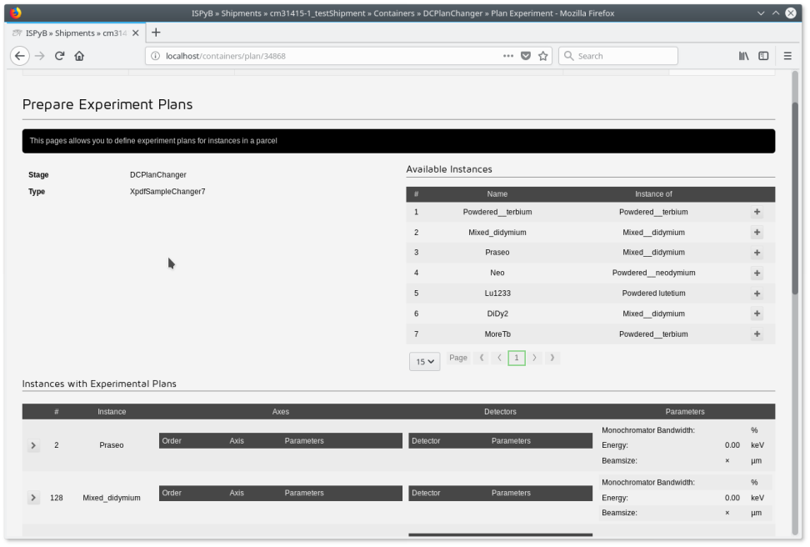
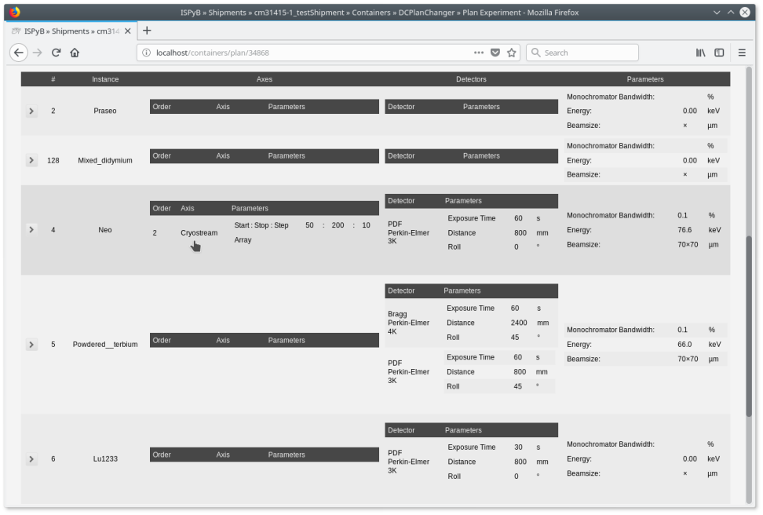
Experiment planning

Slide 13
Future work
Defining Data Collections for XPDF
Extracting metadata and data locations for processing
Storing processing results in the database
Retrieving processed results
Displaying raw data in SynchWeb
Displaying processed data in SynchWeb

Slide 14
Database needs
Experimental results
XPDF processing results
Autoprocessing fields
Derived from AutoProc tables?

Slide 15
Summary
Experimental definition complete
Display of Data Collections should be generic
Define functions to retrieve metadata for processing
Partially complete
Storing and retrieving processing results needs investigating
Processing algorithm not yet finished

